Slide 1


Social Buzz
Content Categories

Slide 2

Today's agenda
Project recap
Problem
The Analytics team
Process
Insights
Summary

Slide 3

Social Buzz is a fast-growing technology unicorn that needs to adapt quickly to its global scale. Accenture has begun a 3 month POC focusing on these tasks:
An audit of Social Buzz's big data practice.
Recommendations for a successful analysis to find Social Buzz's top 5 most popular categories of content.
Project Recap

Slide 4

Over 100000 posts per day
36,500,000 pieces of content per year!
But how to capitalize on it when there is so much?
Analysis to find Social Buzz's top 5 most popular categories of content
Problem

Slide 5




Andrew Fleming
Chief Technical Architect
The Analytics team
Marcus Rompton Senior Principle
Priyadarshini Maddela Data Analyst

Slide 6
Process
Data Collection: Gathered sample data sets containing information about content categories and their respective popularity metrics.
1
2
Data Preprocessing: Cleaned and prepared the data, handling missing values, removing duplicates, and ensuring data consistency.
3
Exploratory Data Analysis (EDA): Examined the distribution of content categories, calculated aggregate scores/popularity metrics, and identified trends.
4
Visualization: Created visualizations such as histograms, bar charts, and pie charts to represent the distribution of scores/popularity across different categories.
5
Analysis and Conclusion: Analyzed the visualizations to understand popularity trends, identified top-ranking categories, and drew conclusions to inform content strategy decisions

Slide 7

Insights
16
Unique Categories
1858
Reactions to ANIMAL posts
January
Month with Most Posts

Slide 8
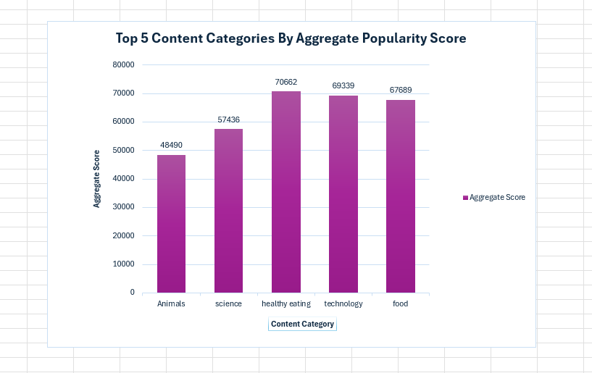

Slide 9
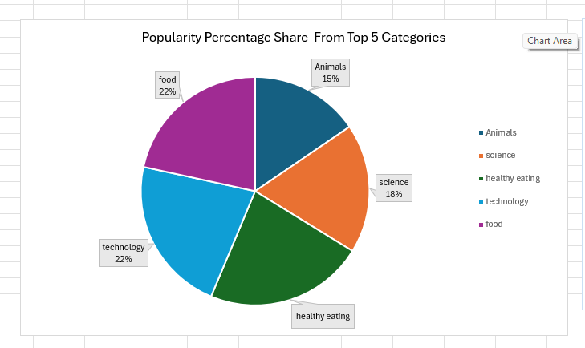

Slide 10

Summary
ANALYSIS
Animals, Science, Healthy Eating, Technology, and Food are the five most popular categories of content, showing that people enjoy "real-life" and "Tactus content the most.
INSIGHT
Food is a common theme in the top 5 categories with “Health ranking the highest. This may indicate the audience within your user base. You could use this insight to create a campaign and work with healthy eating brands to boost user engagement.

Slide 11
Thank you!
ANY QUESTIONS?

